Slide 1
THG Simulations
Project update
Week 6
??/08/2023
David Amorim

Slide 2
I. EFFECTS OF CHIRP

Slide 3
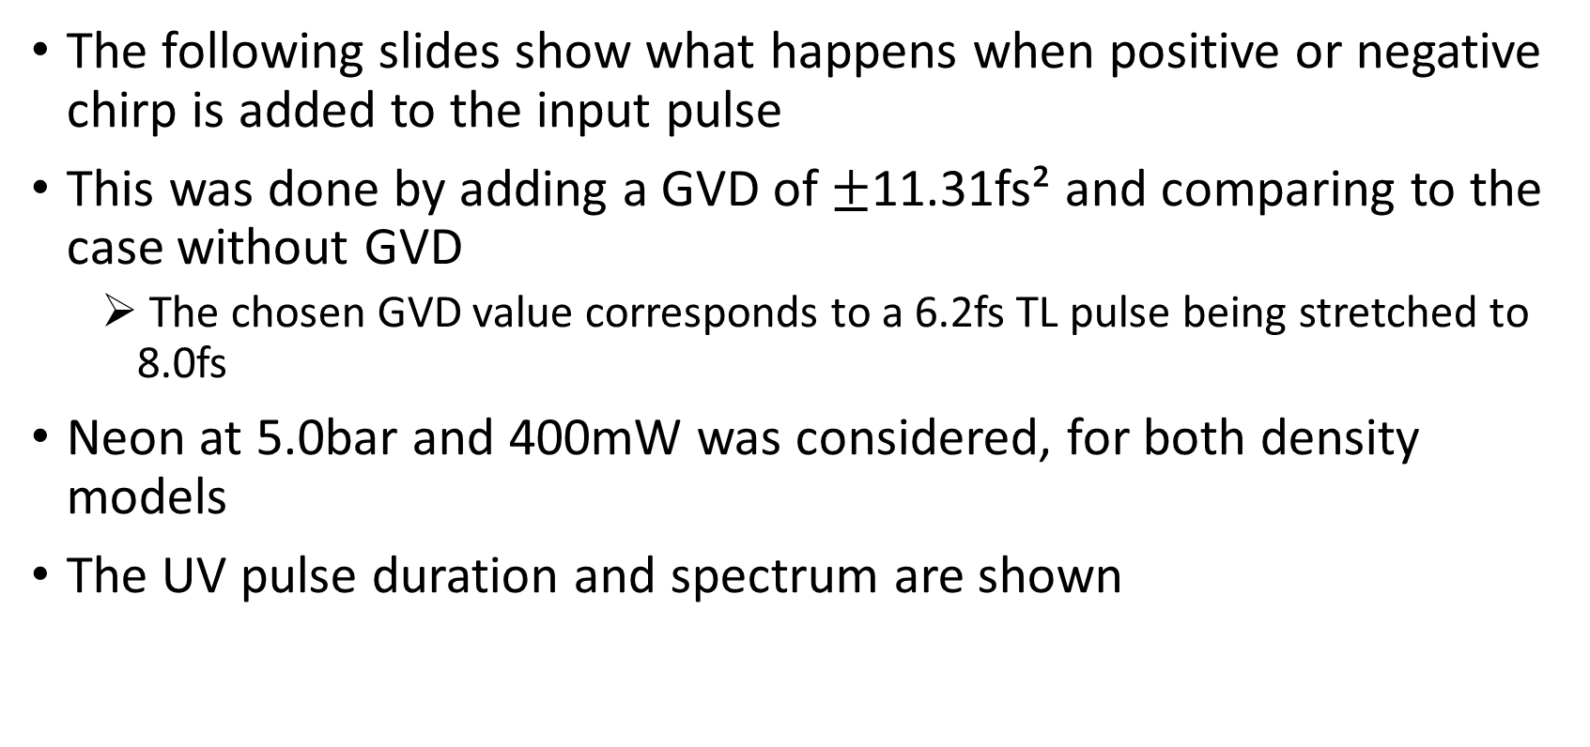
Effects of chirp
The following slides show what happens when positive or negative chirp is added to the input pulse
This was done by adding a GVD of $±$11.31fs² and comparing to the case without GVD
The chosen GVD value corresponds to a 6.2fs TL pulse being stretched to 8.0fs
Neon at 5.0bar and 400mW was considered, for both density models
The UV pulse duration and spectrum are shown

Slide 4
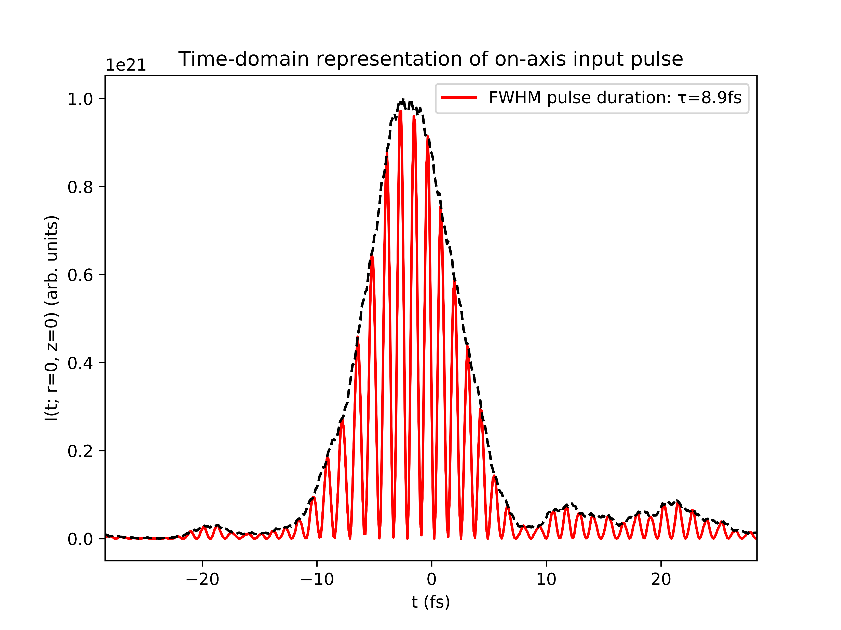
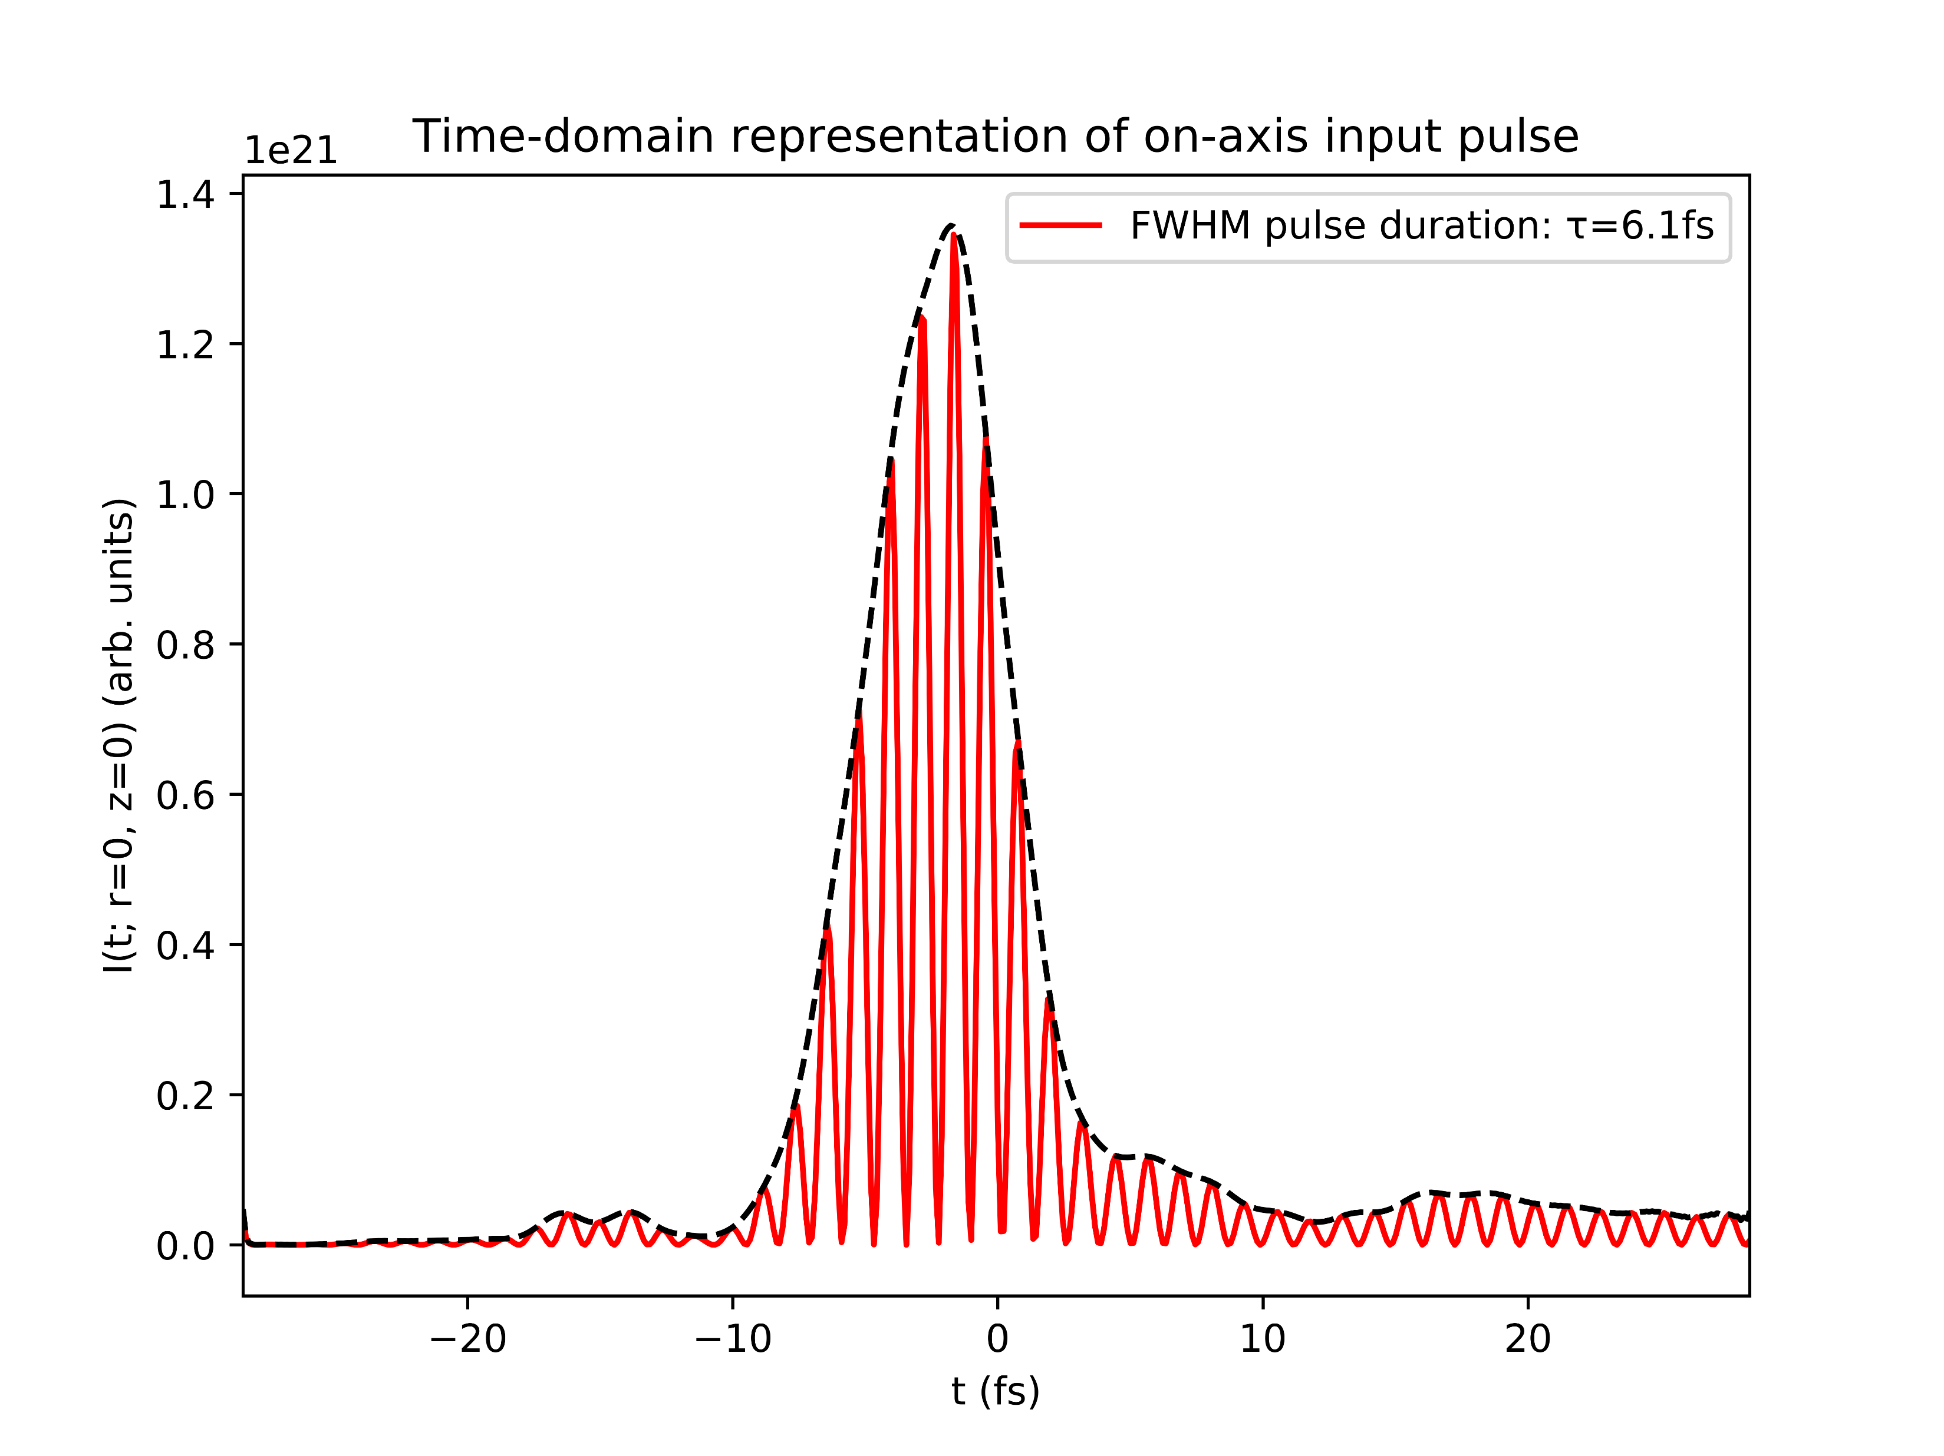
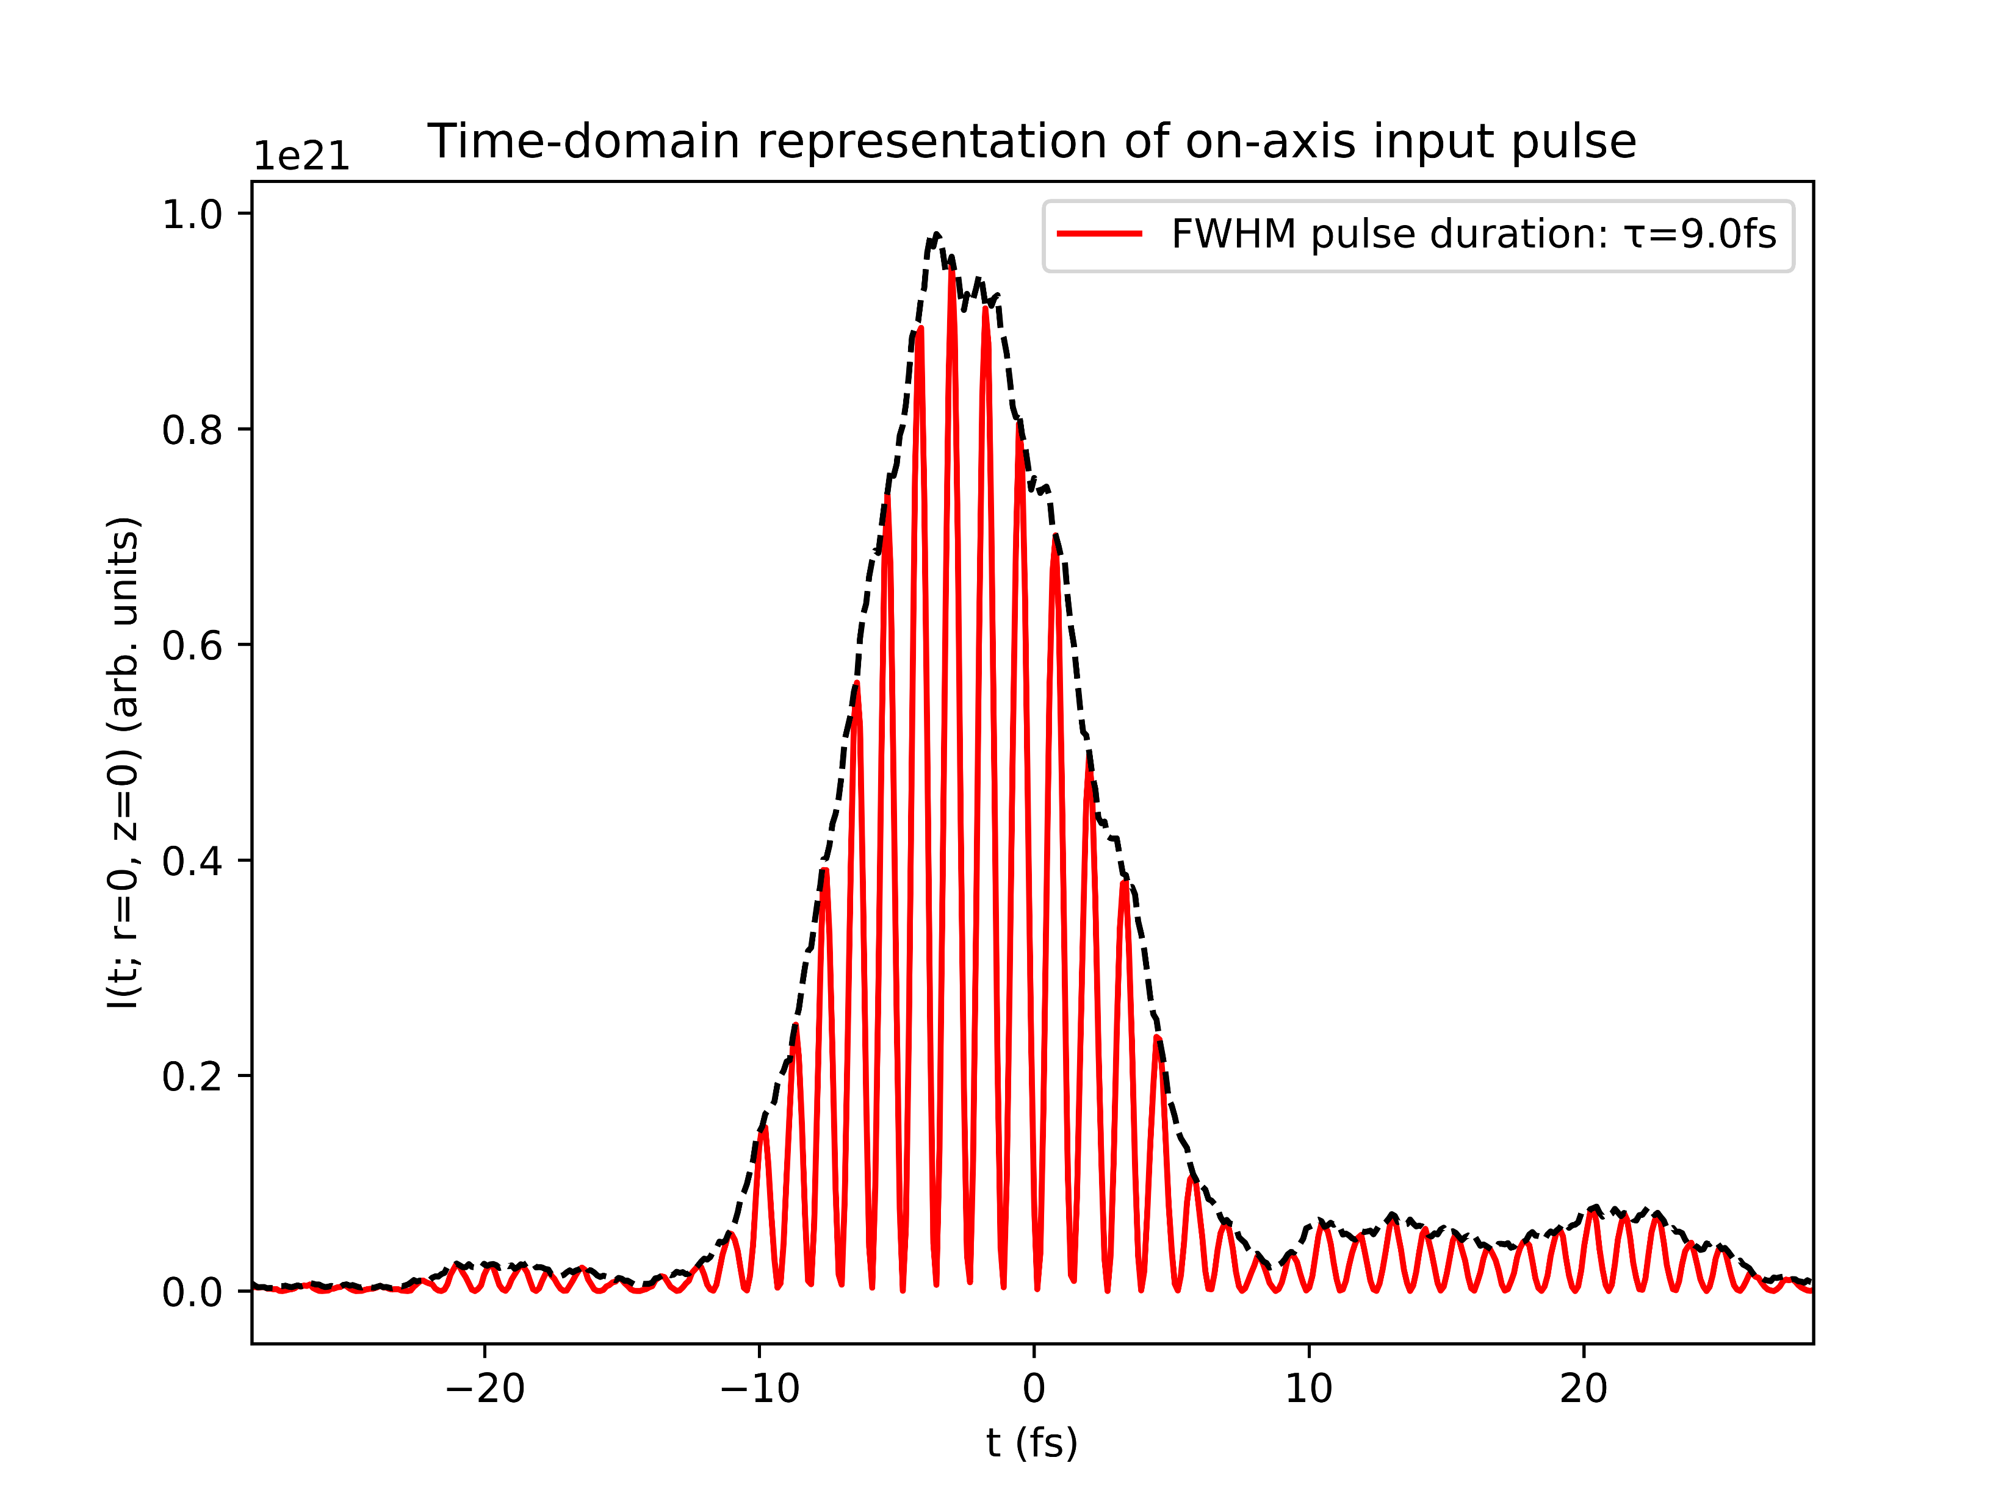
Effects of chirp: both models
+ve chirp
no chirp
-ve chirp

Slide 5
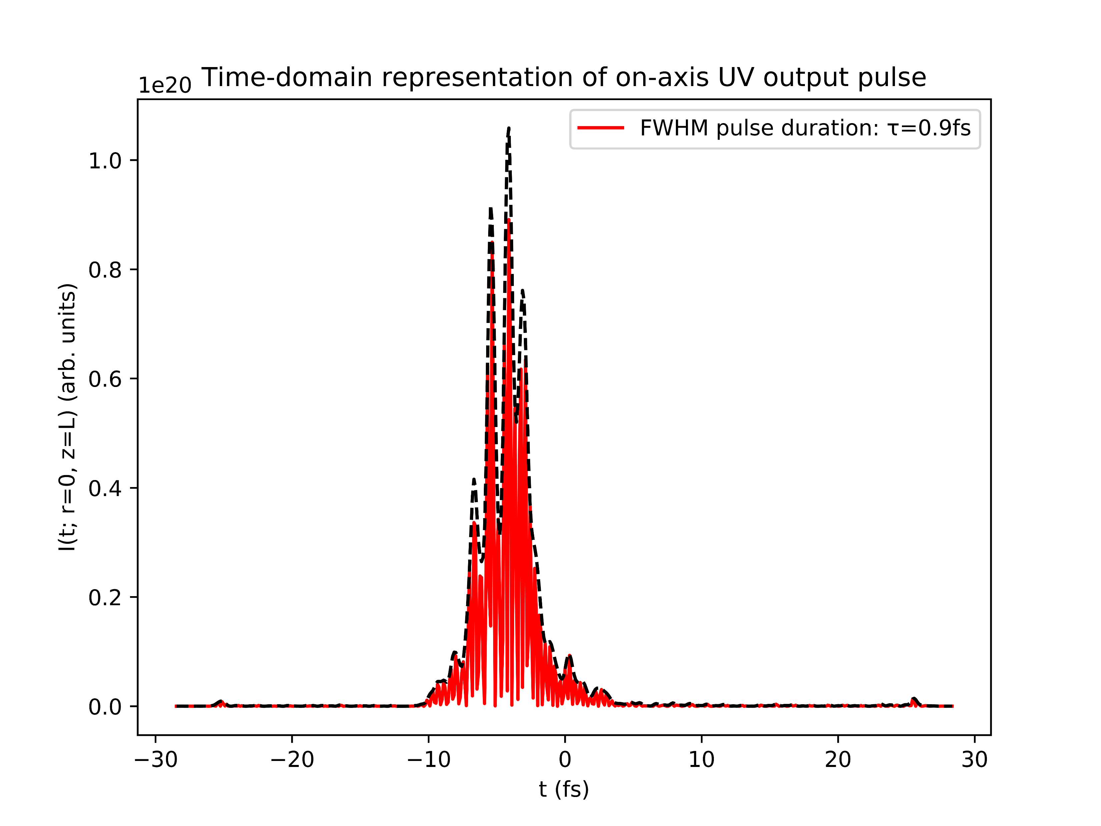
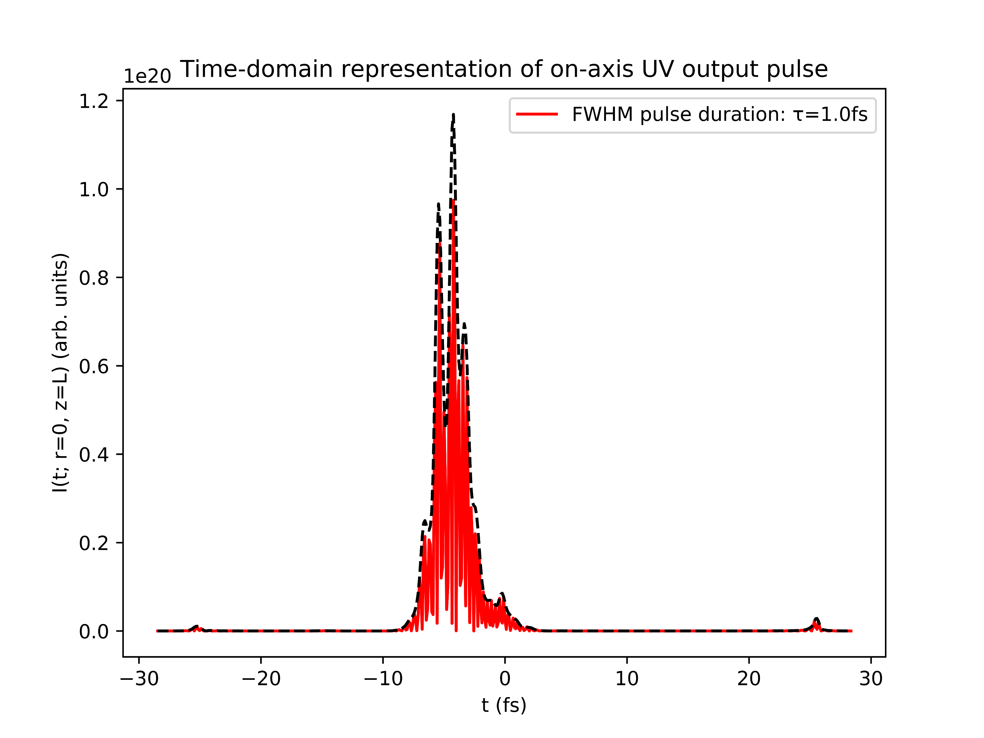
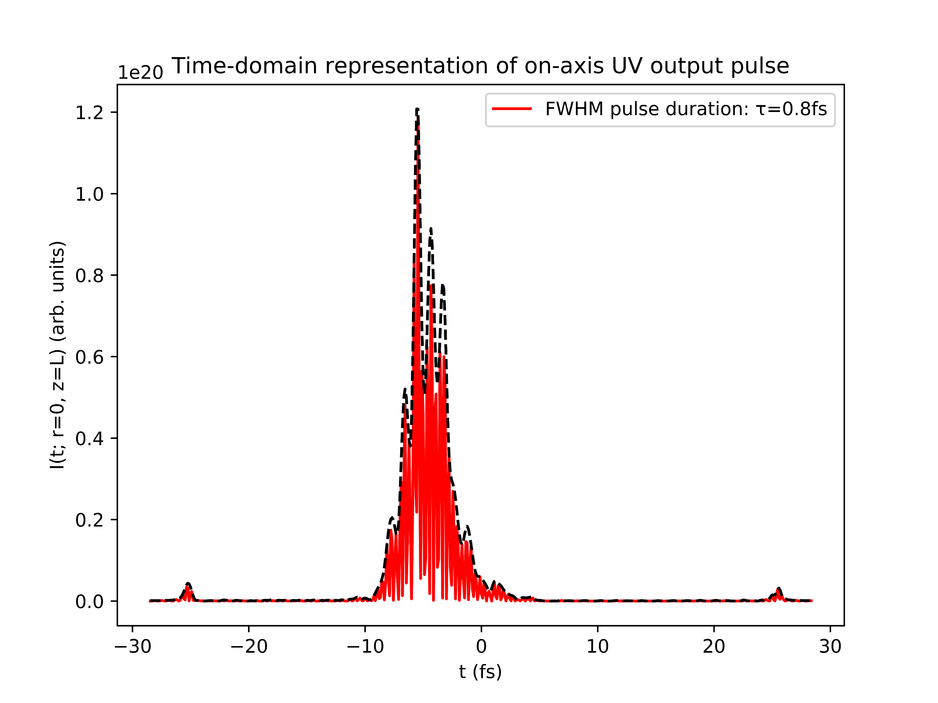
Effects of chirp: gradient model
+ve chirp
no chirp
-ve chirp

Slide 6
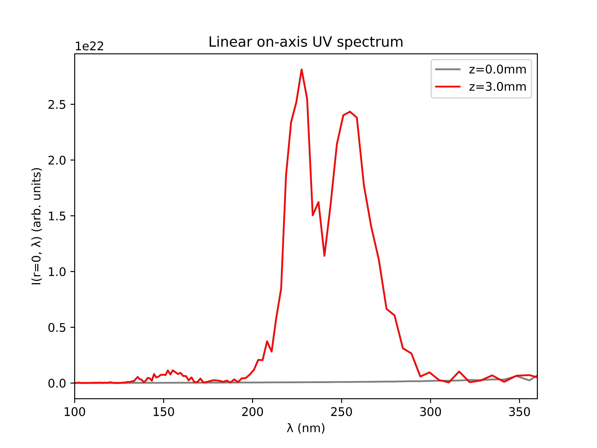
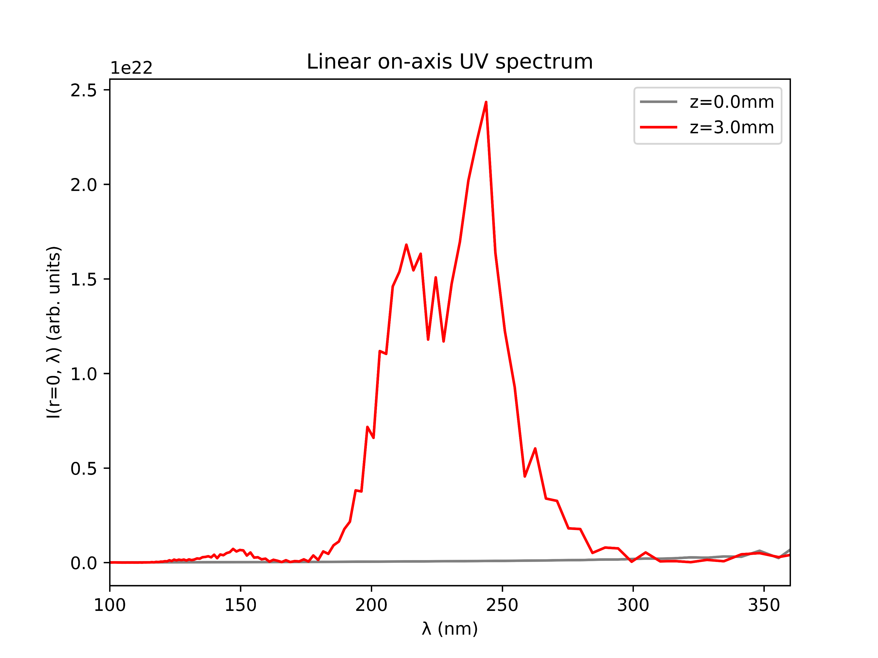
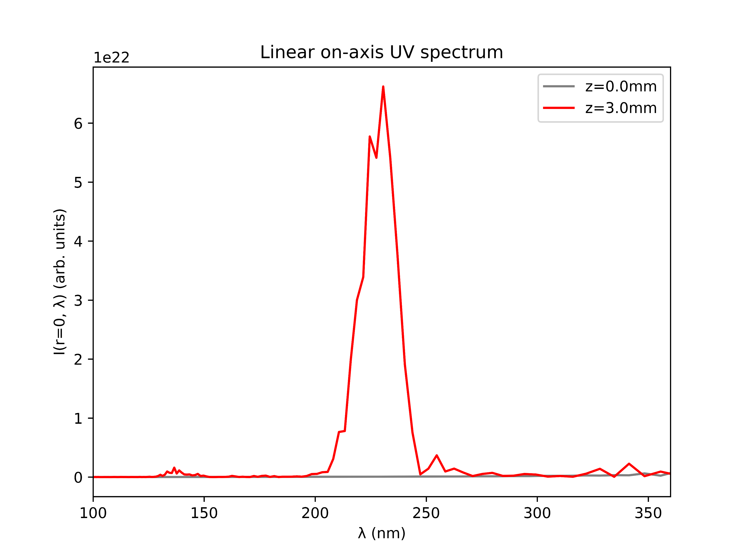
Effects of chirp: gradient model
+ve chirp
no chirp
-ve chirp

Slide 7
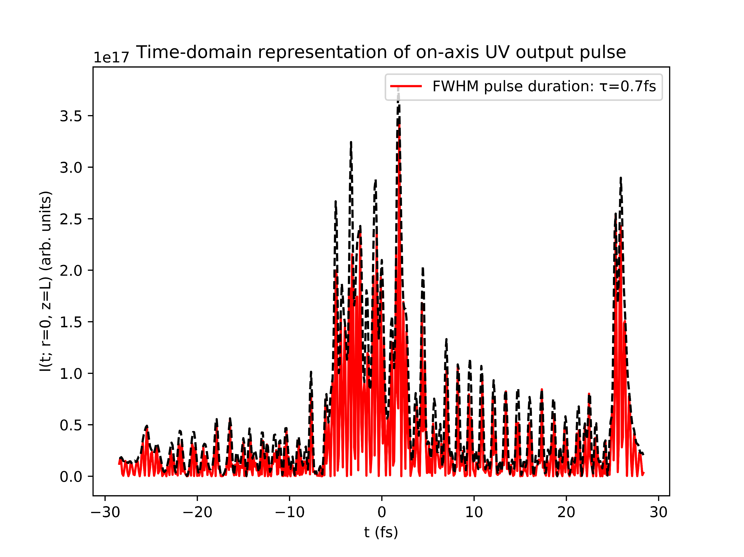
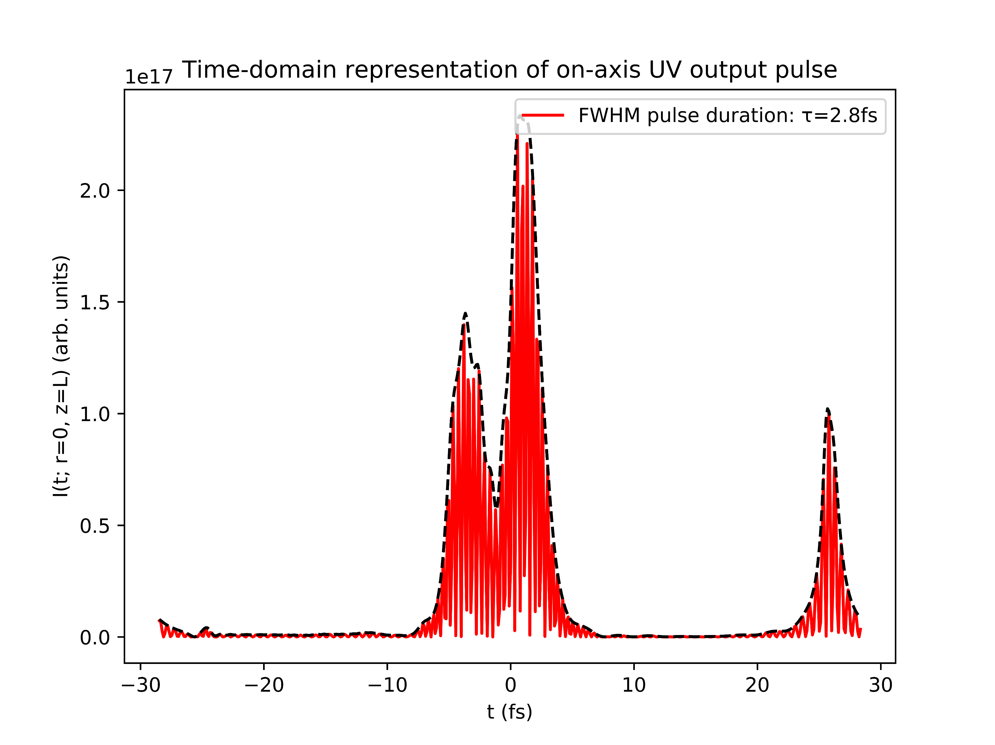
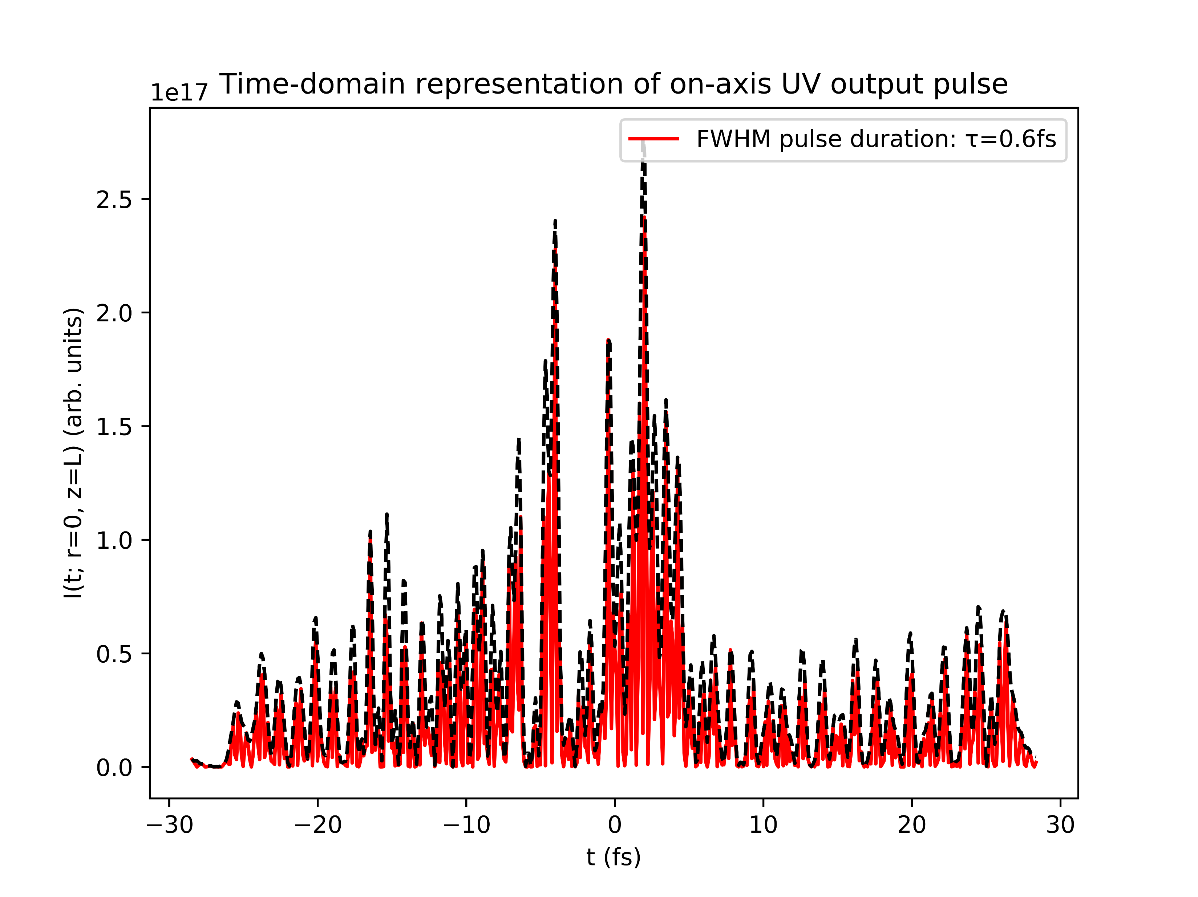
Effects of chirp: COMSOL model
+ve chirp
no chirp
-ve chirp

Slide 8
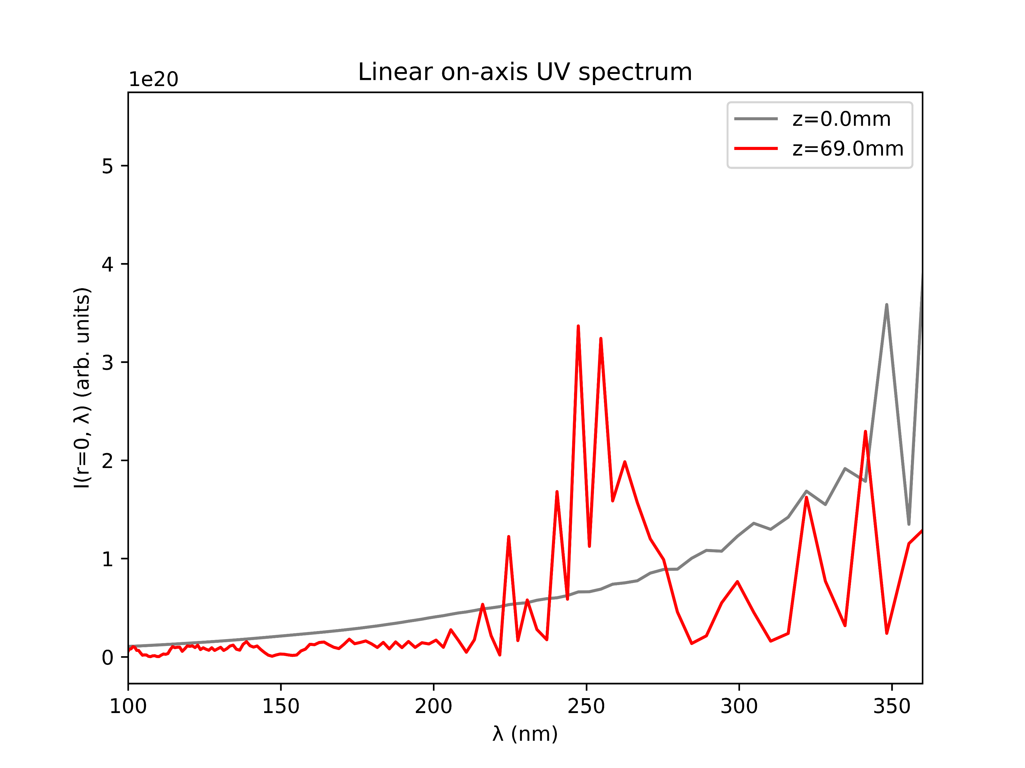
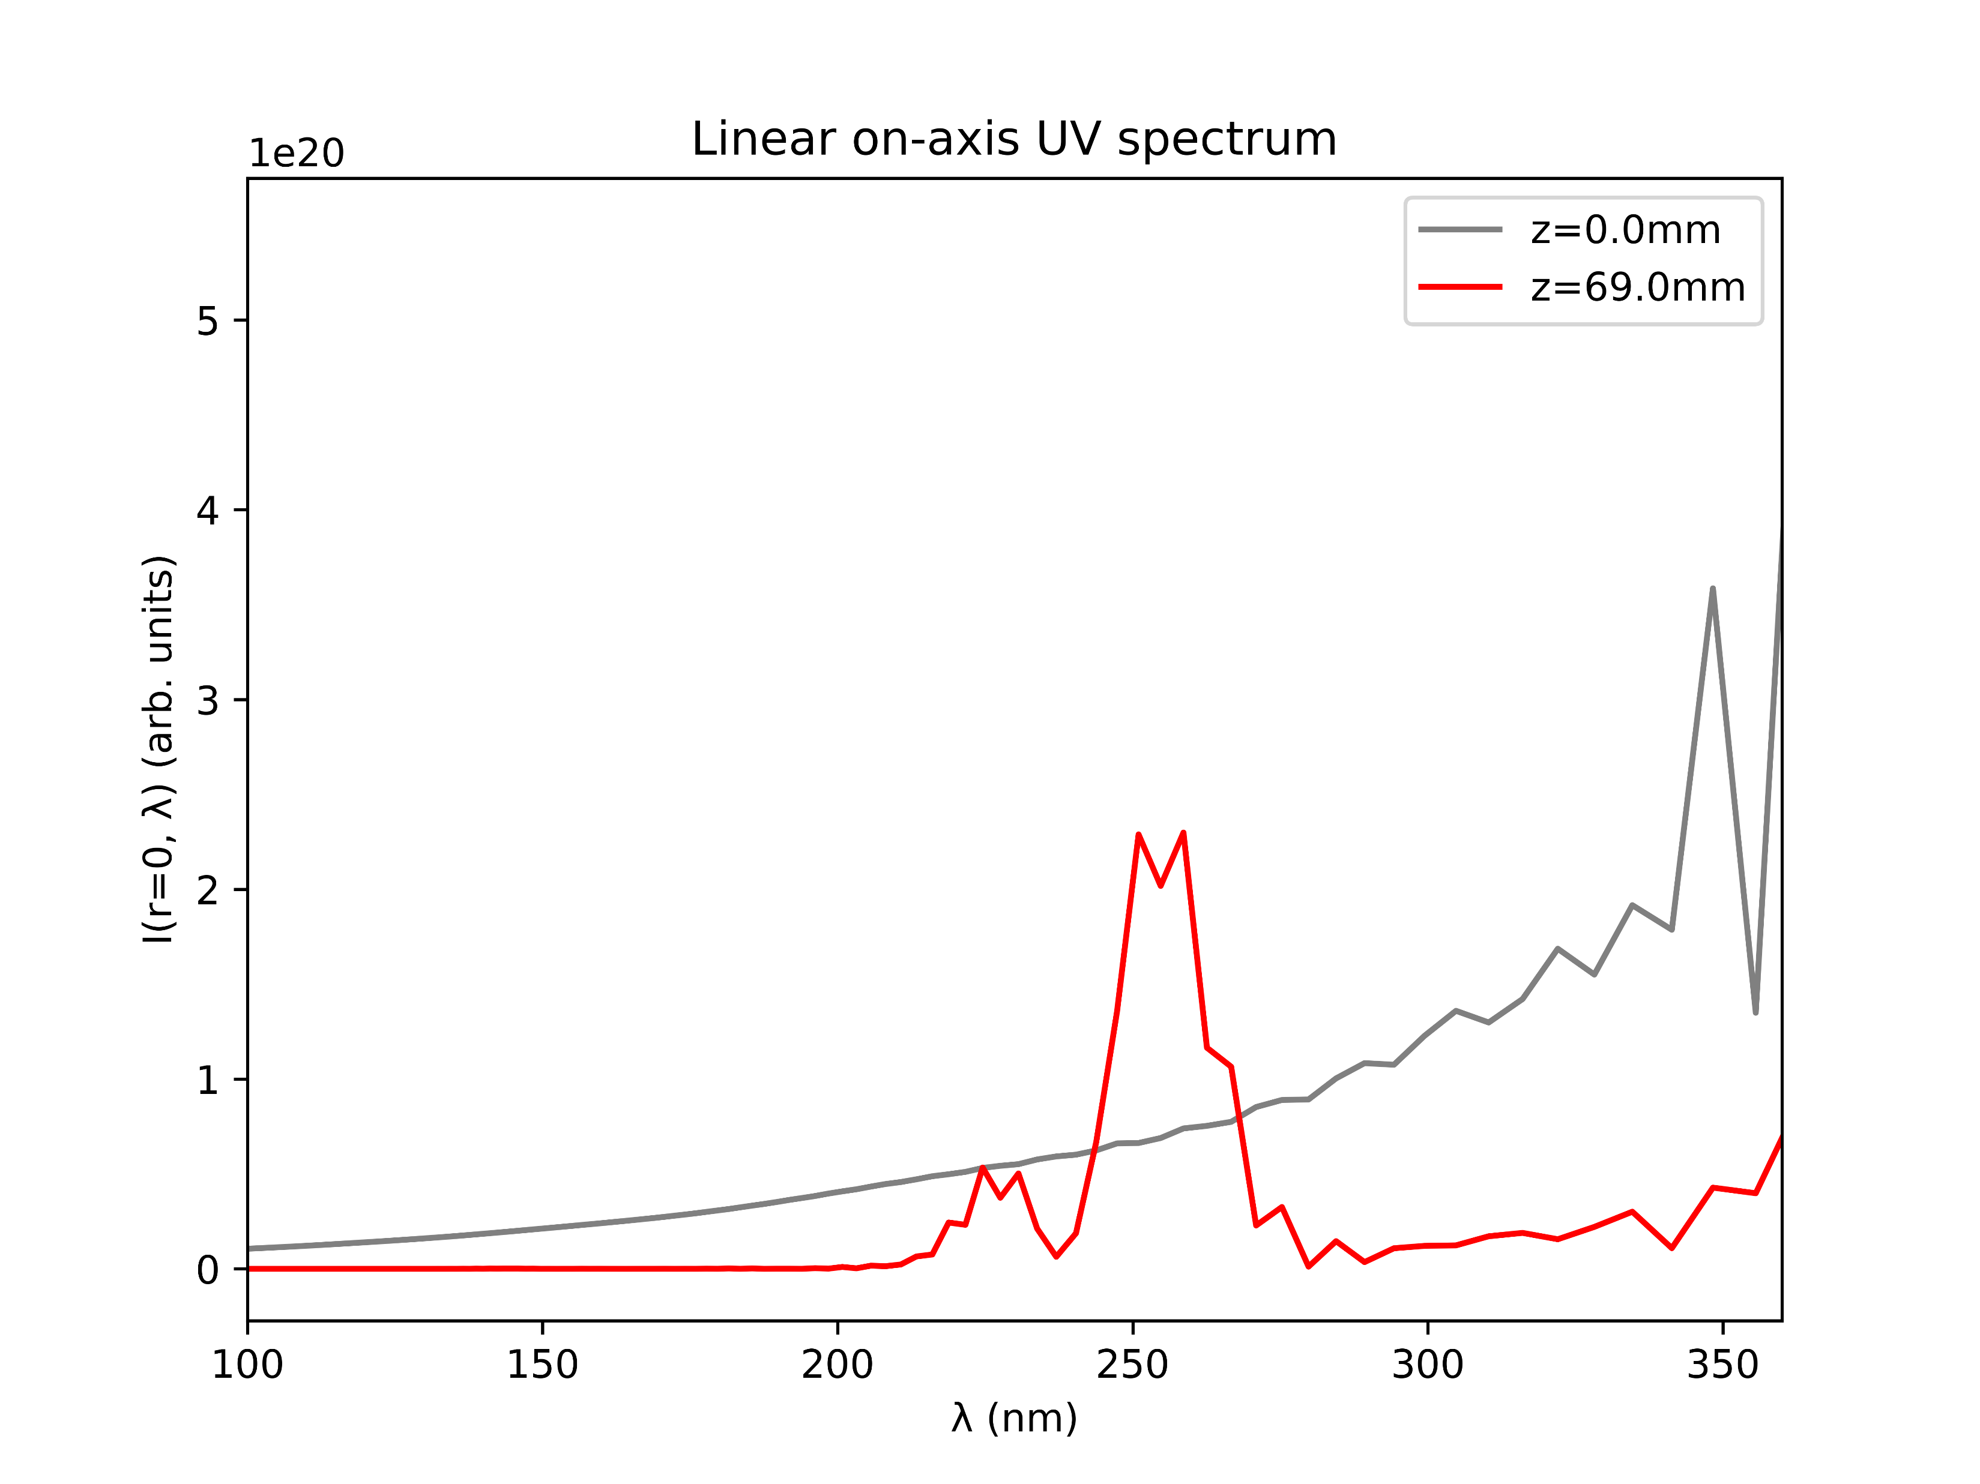
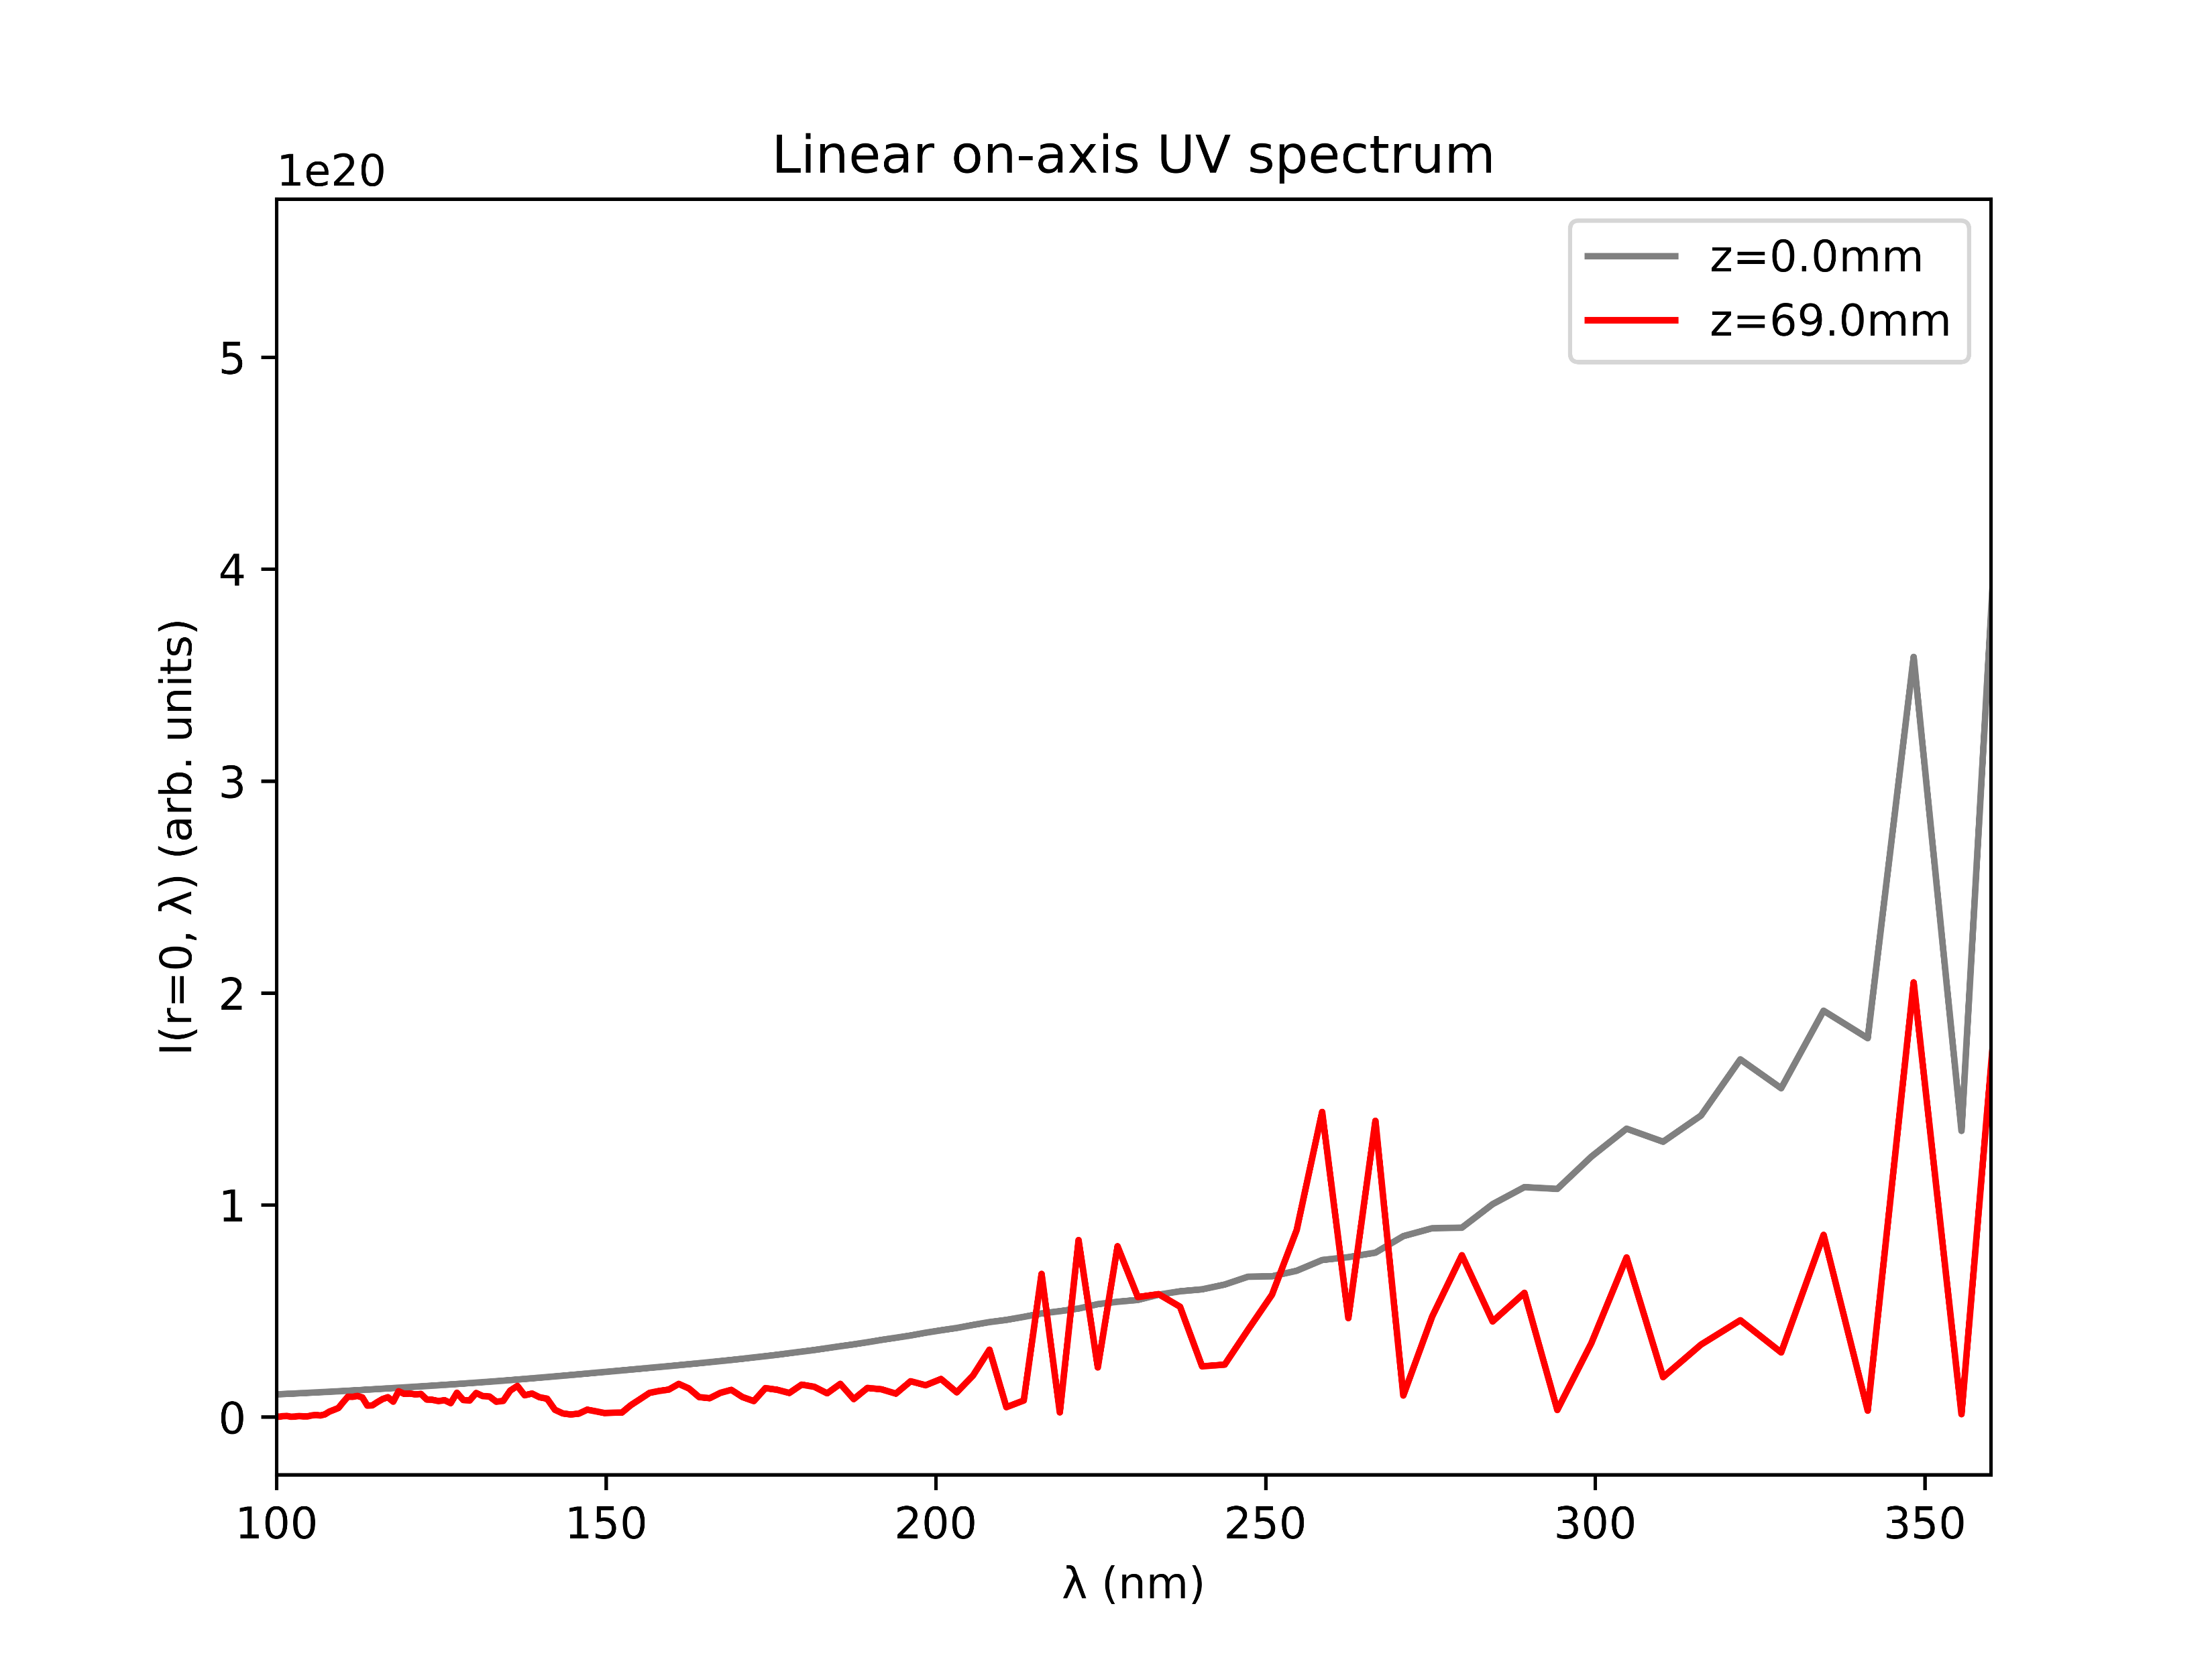
Effects of chirp: COMSOL model
+ve chirp
no chirp
-ve chirp

Slide 9
Effects of chirp: conclusion
Introducing chirp results in shorter pulses in both the COMSOL and gradient models
negative chirp seems to produce slightly shorter pulses than positive chirp
in the COMSOL model, chirp significantly deforms the UV output beam
In the gradient model, negative chirp increases UV intensity and narrows the spectrum around the THG peak while positive chirp increases a second peak
In the COMSOL model, chirp mainly introduces smaller additional peaks while diminishing the THG peak
Chirp definitely has some effect; investigate this more?

Slide 10
II. GAS COMPARISON (UPDATED)

Slide 11
Energy saturation (updated)
The table below indicates whether UV energy saturation sets in at the given pressure range (0.1bar to 5.1bar) powers
Thus, there are six saturable gases (Ar, Kr, N2, N2O, O2, SF6) and three non-saturable gases (Ne, He, Xe)
For non-saturable gases: benefit in increasing pressure further!
Beam power | Ar | Ne | He | Kr | Xe | N2 | N2O | O2 | SF6
75mW | Y | N | N | Y | N | Y | Y | Y | Y
150mW | Y | N | N | Y | N | Y | Y | Y | Y
200mW | Y | N | N | Y | N | Y | Y | Y | Y
300mW | Y | N | N | Y | N | Y | Y | Y | Y
400mW | Y | N | N | Y | N | Y | Y | Y | Y
Y: yes for both models; N: no for both models

Slide 12
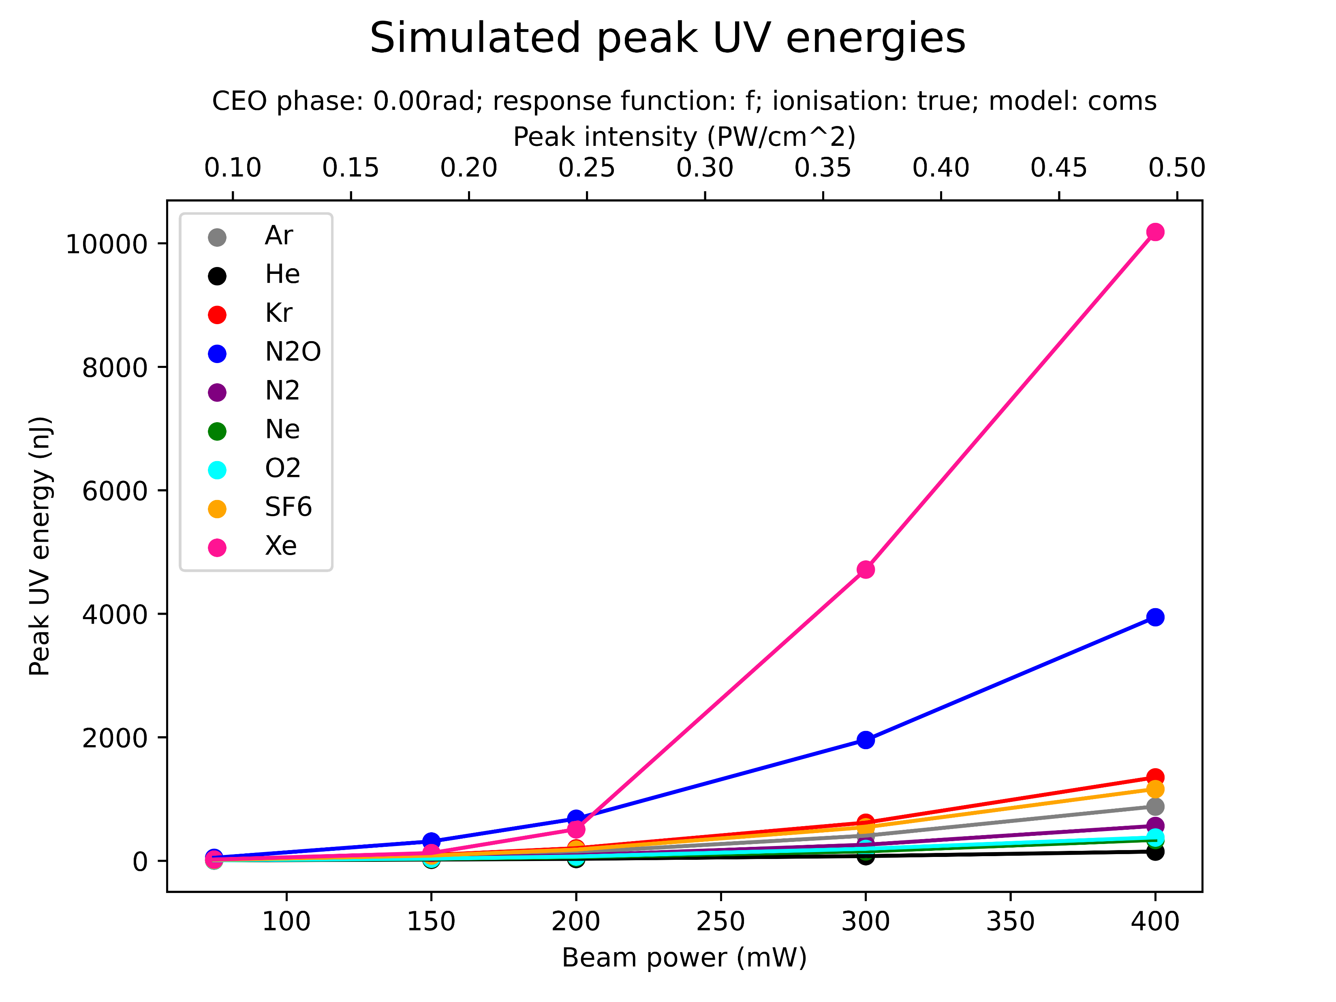
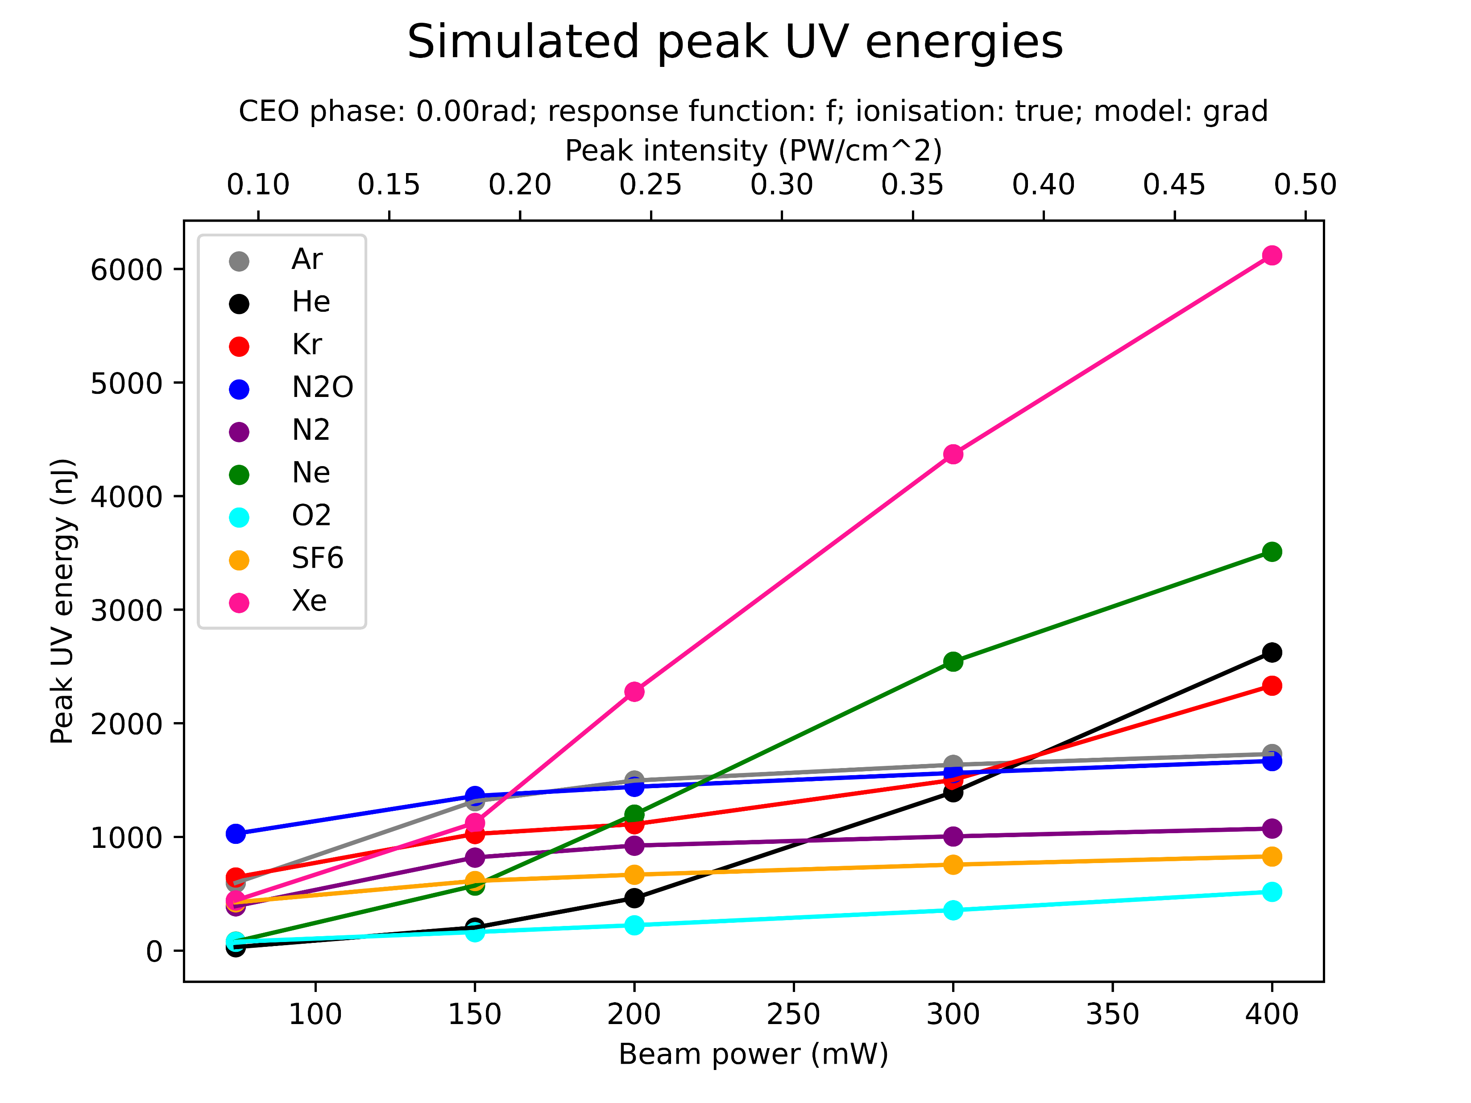
Peak energies (updated)

Slide 13
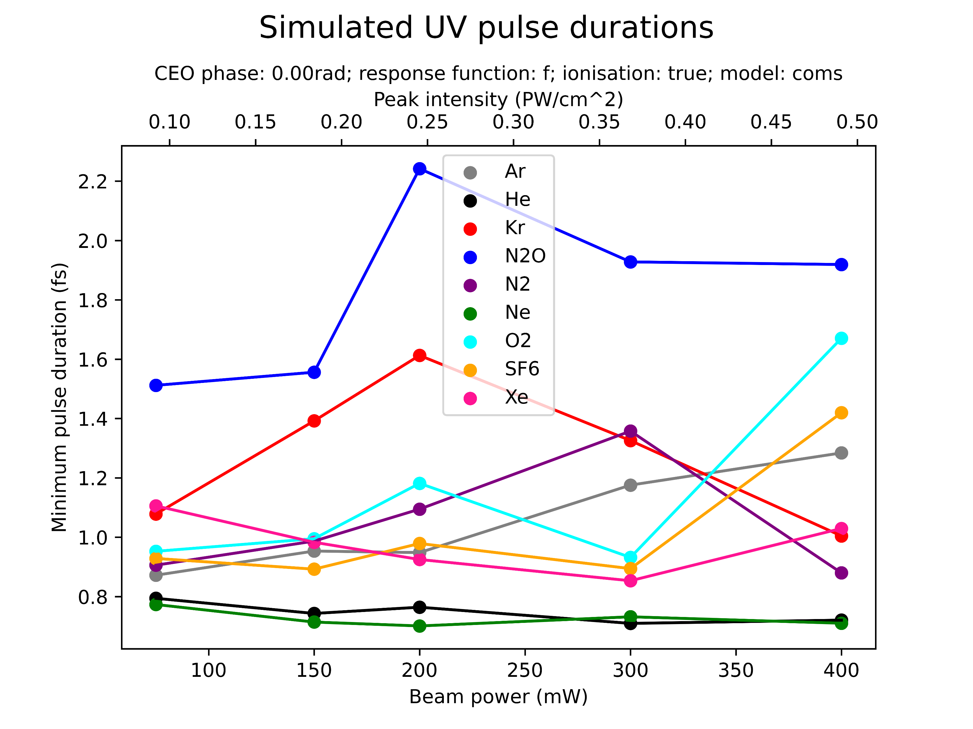
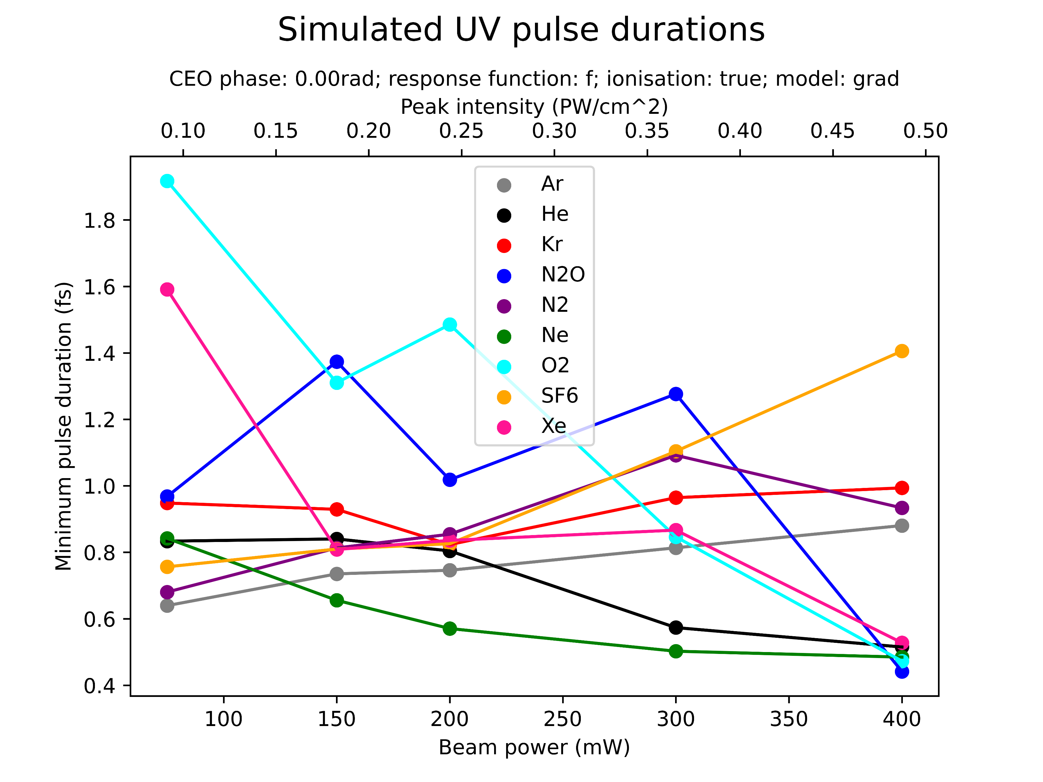
Pulse durations (updated)

Slide 14
Conclusions (updated)
(Note: see Week 5 presentation for comments on the types of plots just shown)
The COMSOL and gradient models differ significantly in their predictions for both the shortest pulse durations and the highest UV energies
UV energies:
The COMSOL model shows Xe and N2O dominating at high beam powers, with Ne and He as the gases with the weakest UV energies
The gradient model also shows Xe dominating but with Ne, He, Kr, and Ar overtaking N2O at high beam powers
Pulse durations:
Both models agree on He and Ne producing the shortest pulses and on Ar being somewhat average

Slide 15
III. QUESTIONS & NEXT STEPS

Slide 16
Next steps
Decide which simulations to run and plots to produce for manuscript and report (“final runs”) [see next slide]
Ideally (necessarily?) with improved high-Mach COMSOL models
Prepare code for final runs while waiting for new COMSOL data
Rewrite code and prepare handover document
PowerPoint on GitHub (still work in progress)
Schedule meeting for handover?
Work on report and presentation
To save time/prioritise: base report and presentation on results for manuscript
Questions: length of presentation, level of background required, formality…?

Slide 17
“Final runs” (?)
To demonstrate agreement between experiment & simulations:
Compare simulated and measured spectra [selected case(s)]
Compare simulated and measured pressure scan UV energy [selected cases]
use optimal conditions (PPT, updated COMSOL model…)
To demonstrate which processes affect THG/beam:
Show self-steepening in spatio-temporal beam profile [with/without ionisation for comparison]
Compare old cell and new chip [if COMSOL data exists]:
Spectra, energies, UV energies as functions of propagation distance
Show different density profiles
To demonstrate which additional parameters might be relevant:
Investigate chirp, CEP, in small parameter scan?

